Slide 1
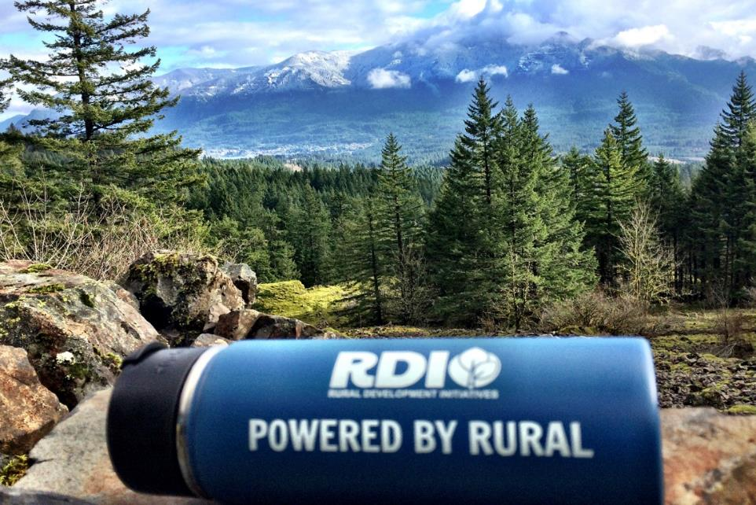
A Pacific Northwest Nonprofit
Cultivating Leaders|Catalyzing Community Led Action
Notes:
1

Slide 2
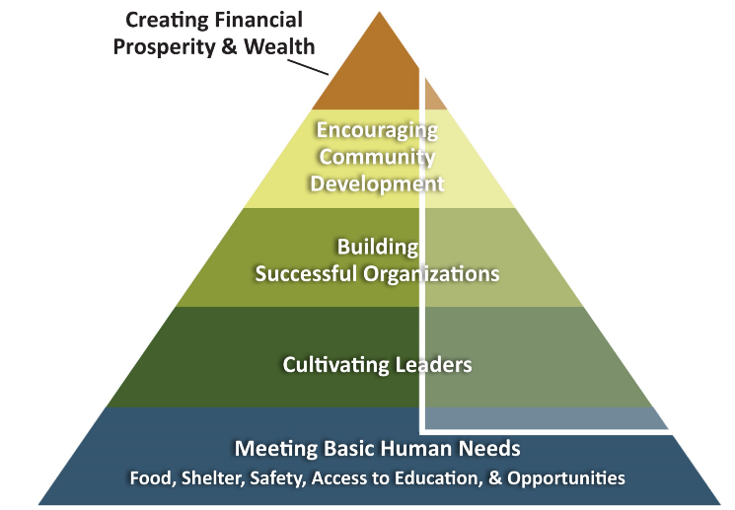
Tupelo Model

Slide 3
Leadership Impacts…
Notes:
3

Slide 4
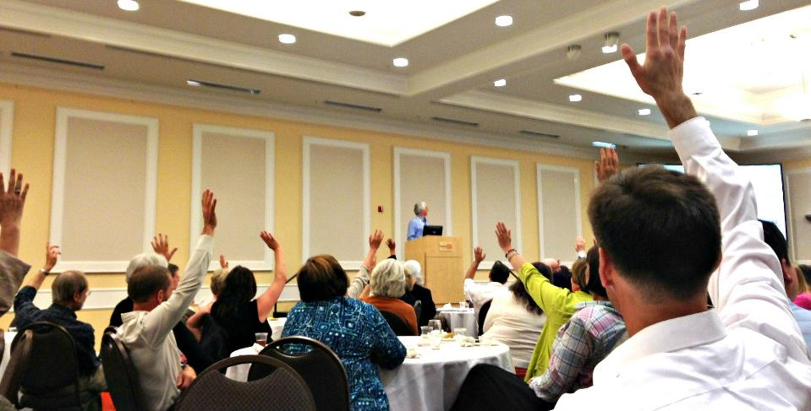
Leadership Impacts
9,000 Leaders Trained
300 Rural Communities Served

Slide 5
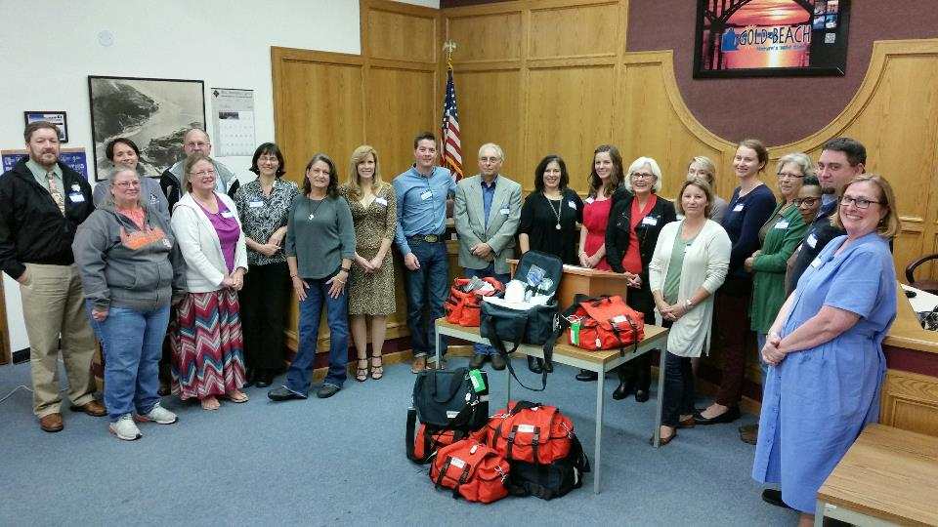
Leadership Impacts
82% said the program increased the number of community leaders in their town

Slide 6
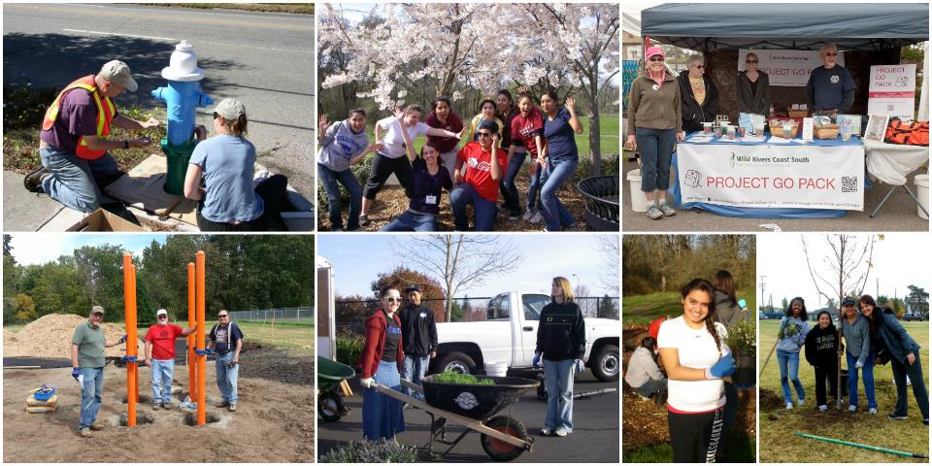
Leadership Impacts
Volunteerism for participants increased nearly four-fold

Slide 7
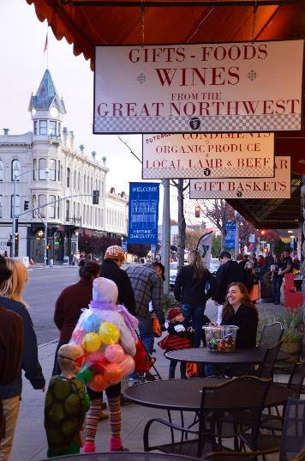
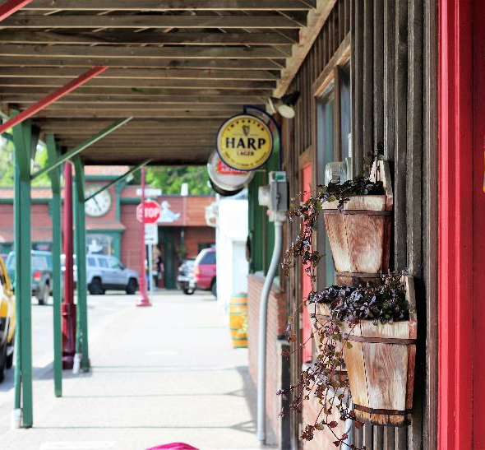
Leadership Impacts
85% reported classes helped them create a better future for their community

Slide 8
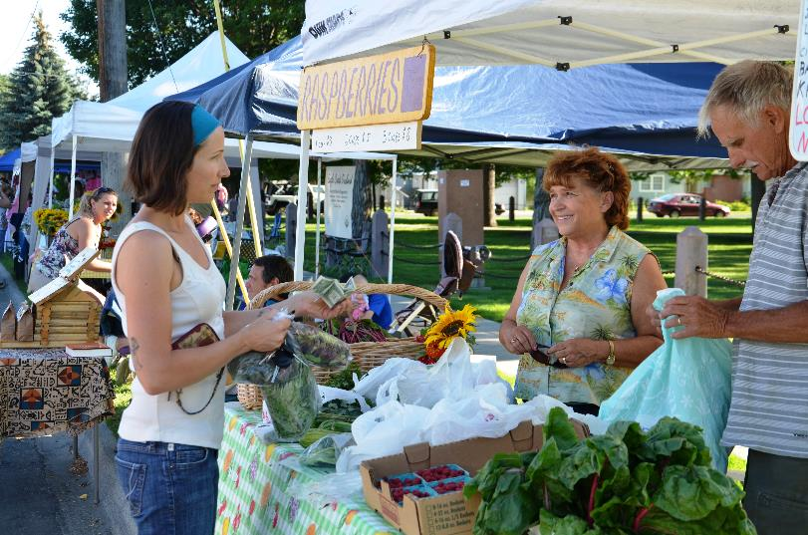
Leadership Impacts
89% increased their appreciation of their community assets

Slide 9
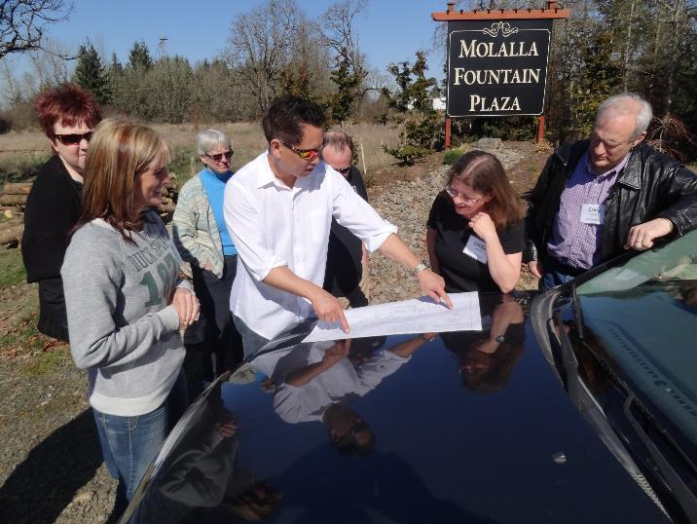
Leadership Impacts
90% expanded their network and resources

Slide 10
Leadership Impacts
92% indicated working more effectively in teams

Slide 11
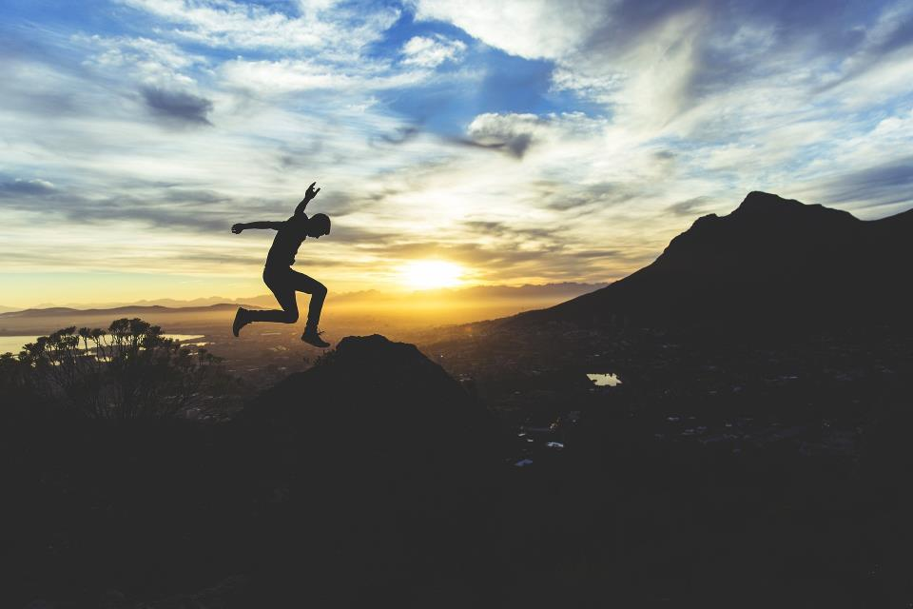
Leadership Impacts
Most described participation as a “life changing experience”

Slide 12
Rural Community Leadership…
Notes:
12

Slide 13
Washington Collaborative Group
Statewide Capacity Collaborative
Partners for Rural Washington
Rural Development Initiatives
Washington Dept. of Commerce
Sherwood Trust
USDA Rural Development
WSU Extension
Association of Washington Cities
Ballmer Group
Yakima Valley Community Foundation
Community Foundation for Southwest Washington

Slide 14
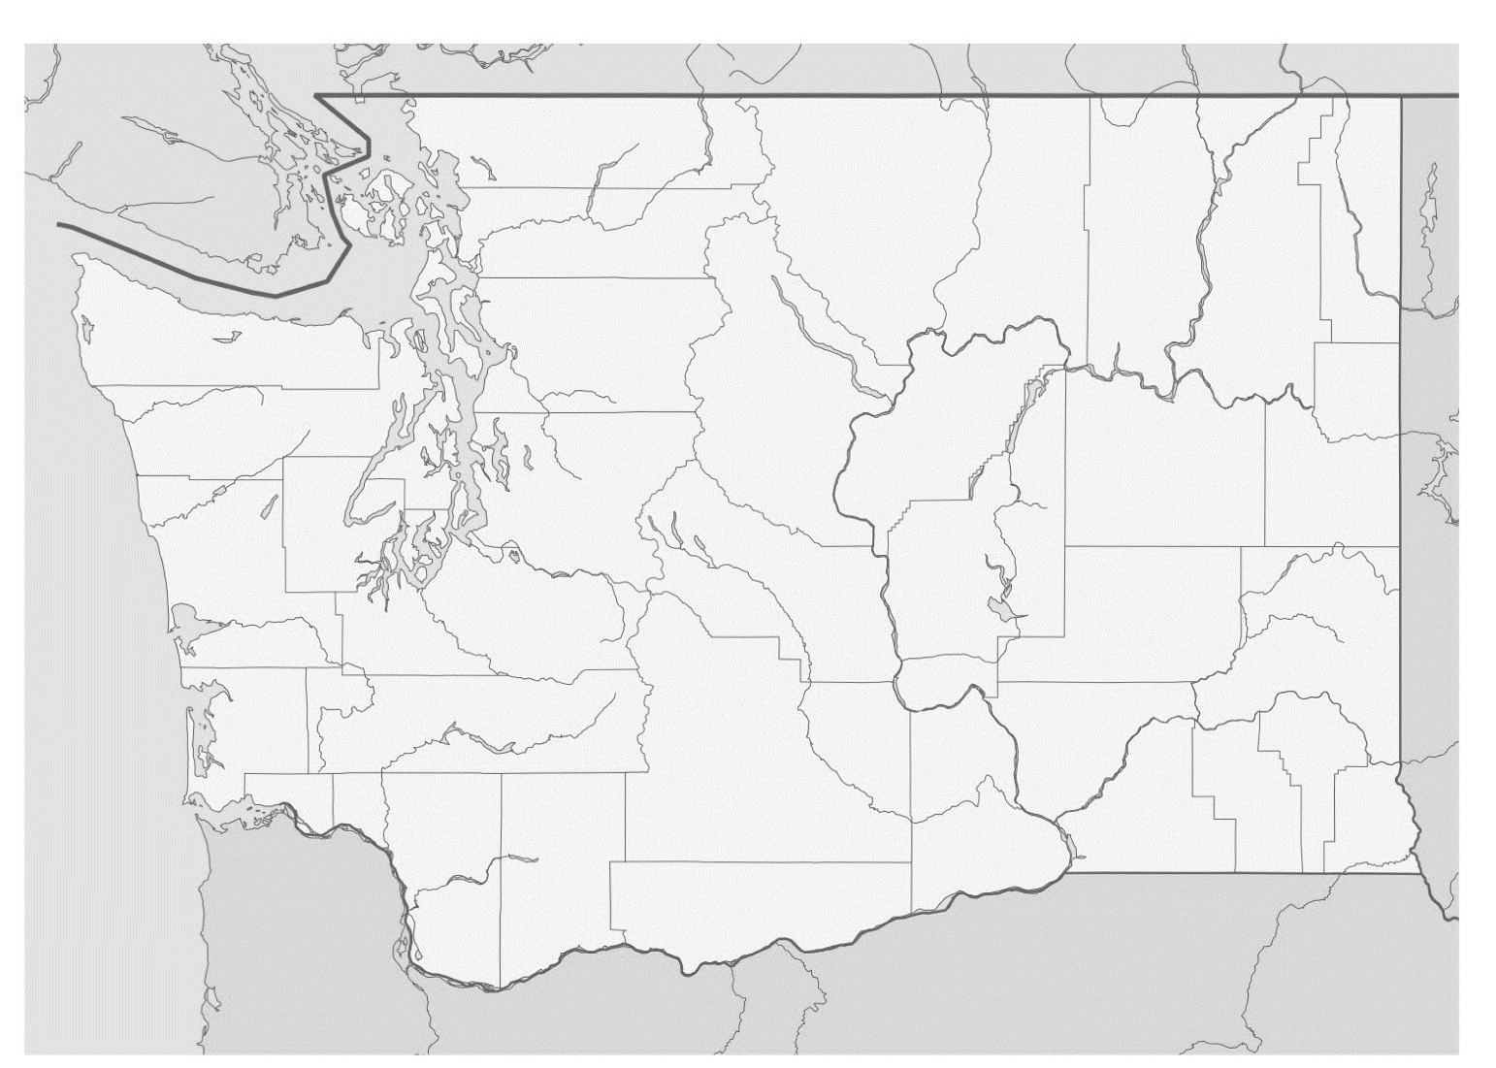
Washington Leadership Cohorts
Mason County
Pierce County
Greater Palouse
Yakima Valley
Thurston County
Dayton
Skamania County
Walla Walla

Slide 15
A Pacific Northwest Nonprofit
Thank you!
☺ Noelle
Cultivating Leaders|Catalyzing Community Led Action
www.rdiinc.org
RDI Phone: 541-687-9077

