Slide 1
Dealing with the expansion of development into Areas that are prone to fire
Deanna Smith, Idaho Smart Growth
Jaap Vos, University of Idaho

Slide 2
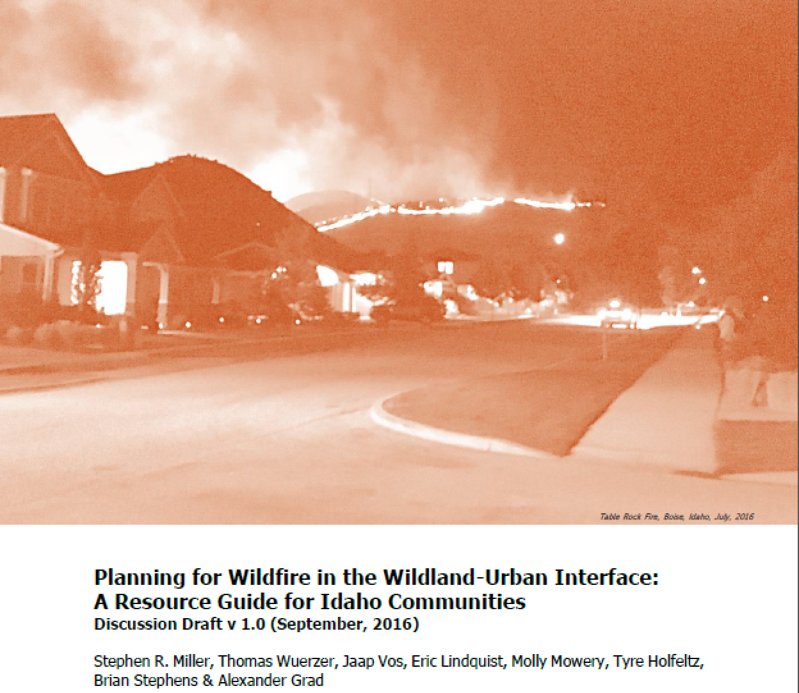

Slide 3
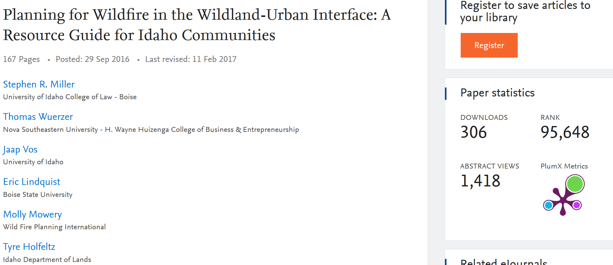

Slide 4
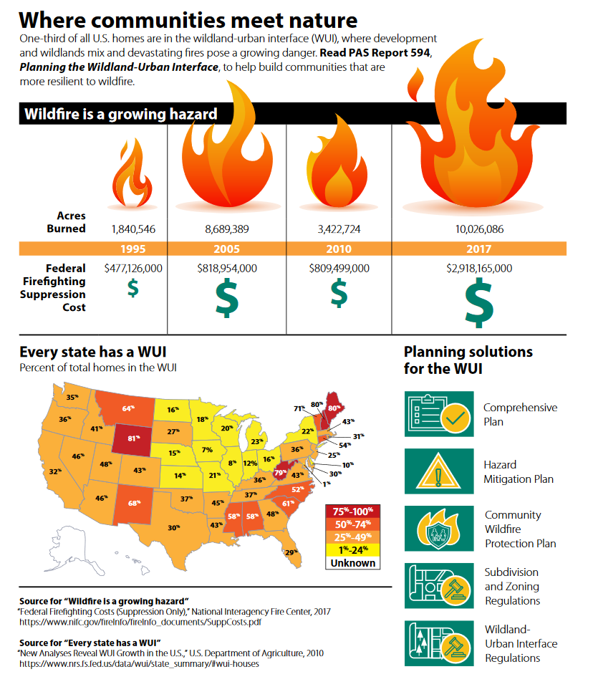

Slide 5
Main Goal:
Broaden the understanding of wildfire, especially at the urban side.

Slide 6
Why?
New development currently leads to increased fire risk and increased costs of suppression, if we do new development “right”, we can decrease risk and costs.

Slide 7
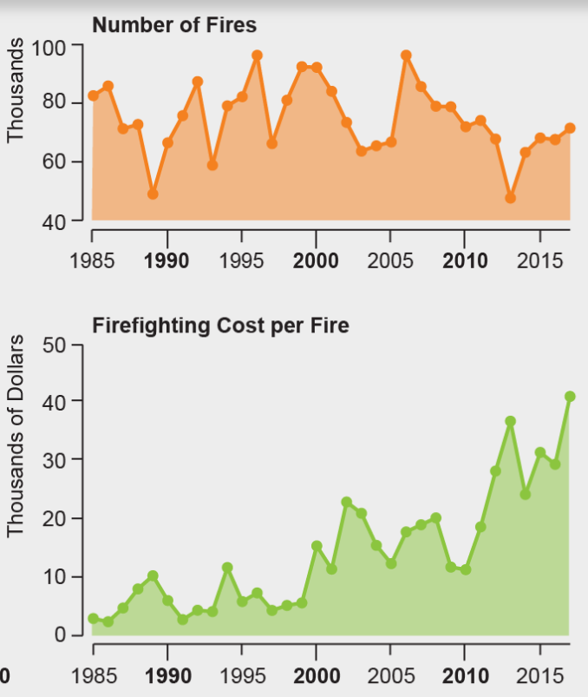

Slide 8
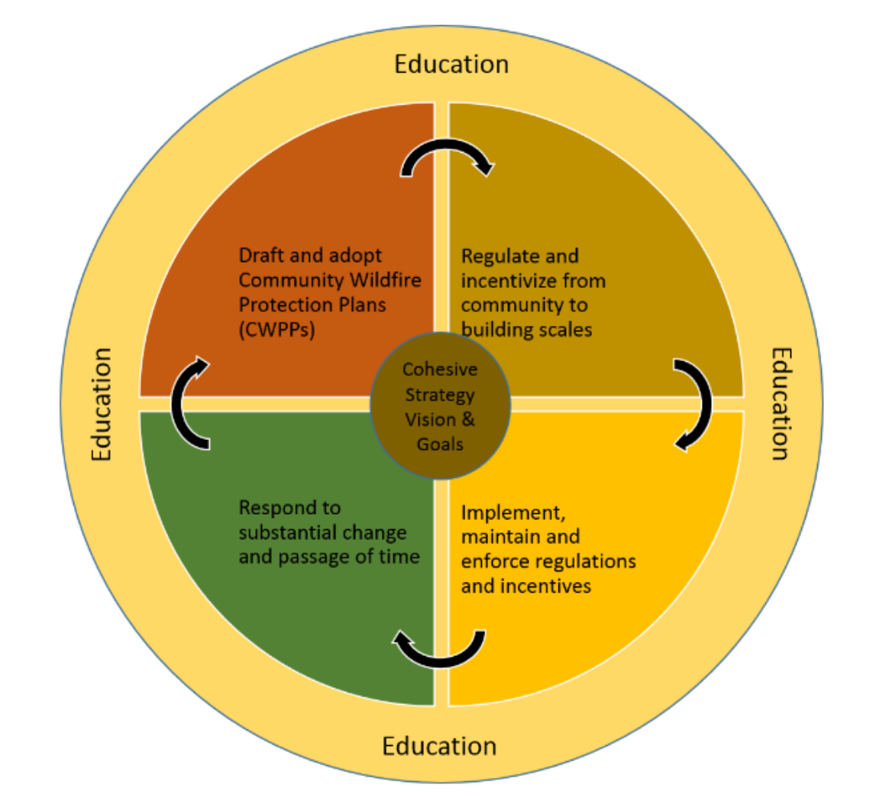
CWPP
Wide variety of stakeholders
Comprehensive Plan
Building Code
Zoning Ordinance
Everybody
Federal and State agencies
Scientists
Specific Stakeholders
Fire Community
Insurance Community
Code Enforcement
P&Z Commission
City Council
HOA
Residents/Landowners

Slide 9
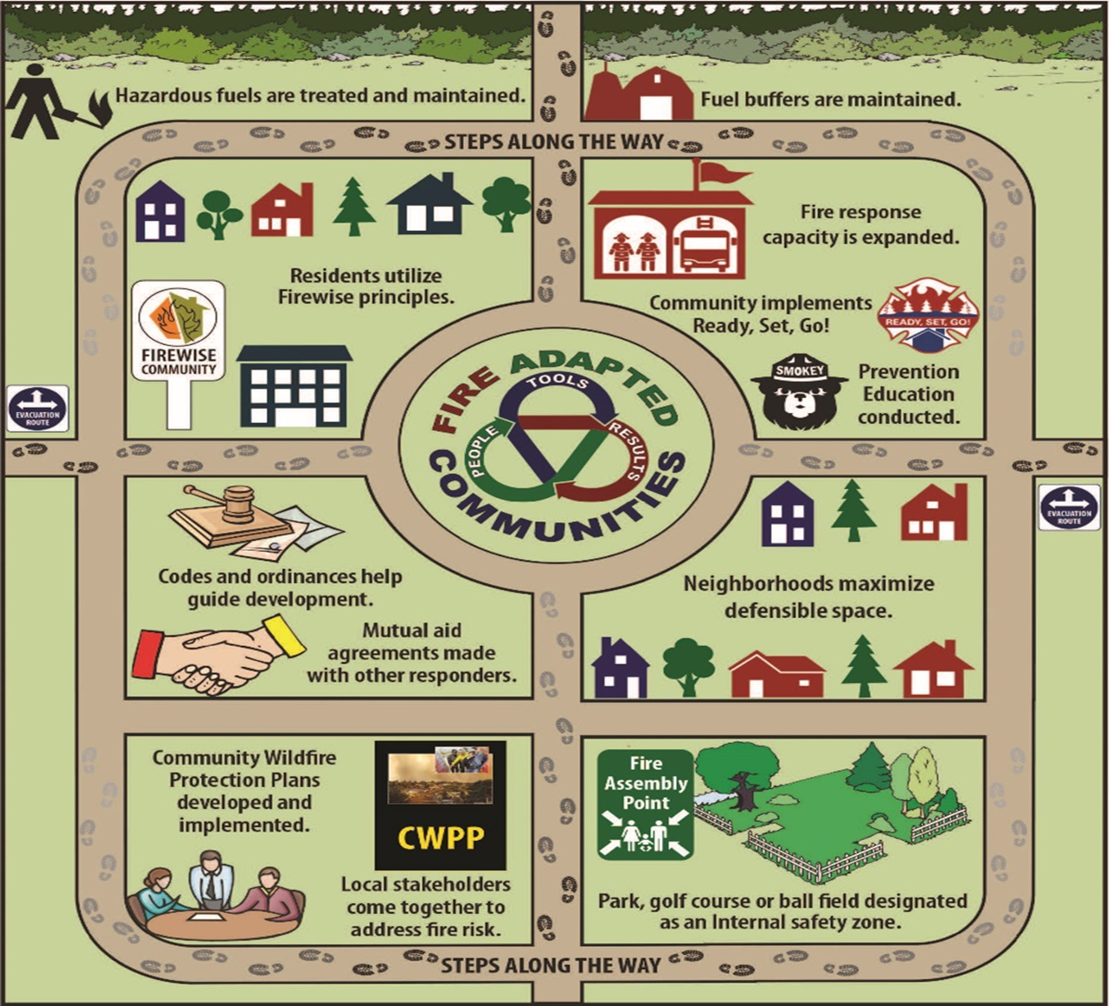

Slide 10
Approach:
Four regional workshops
Six fishbowls

Slide 11
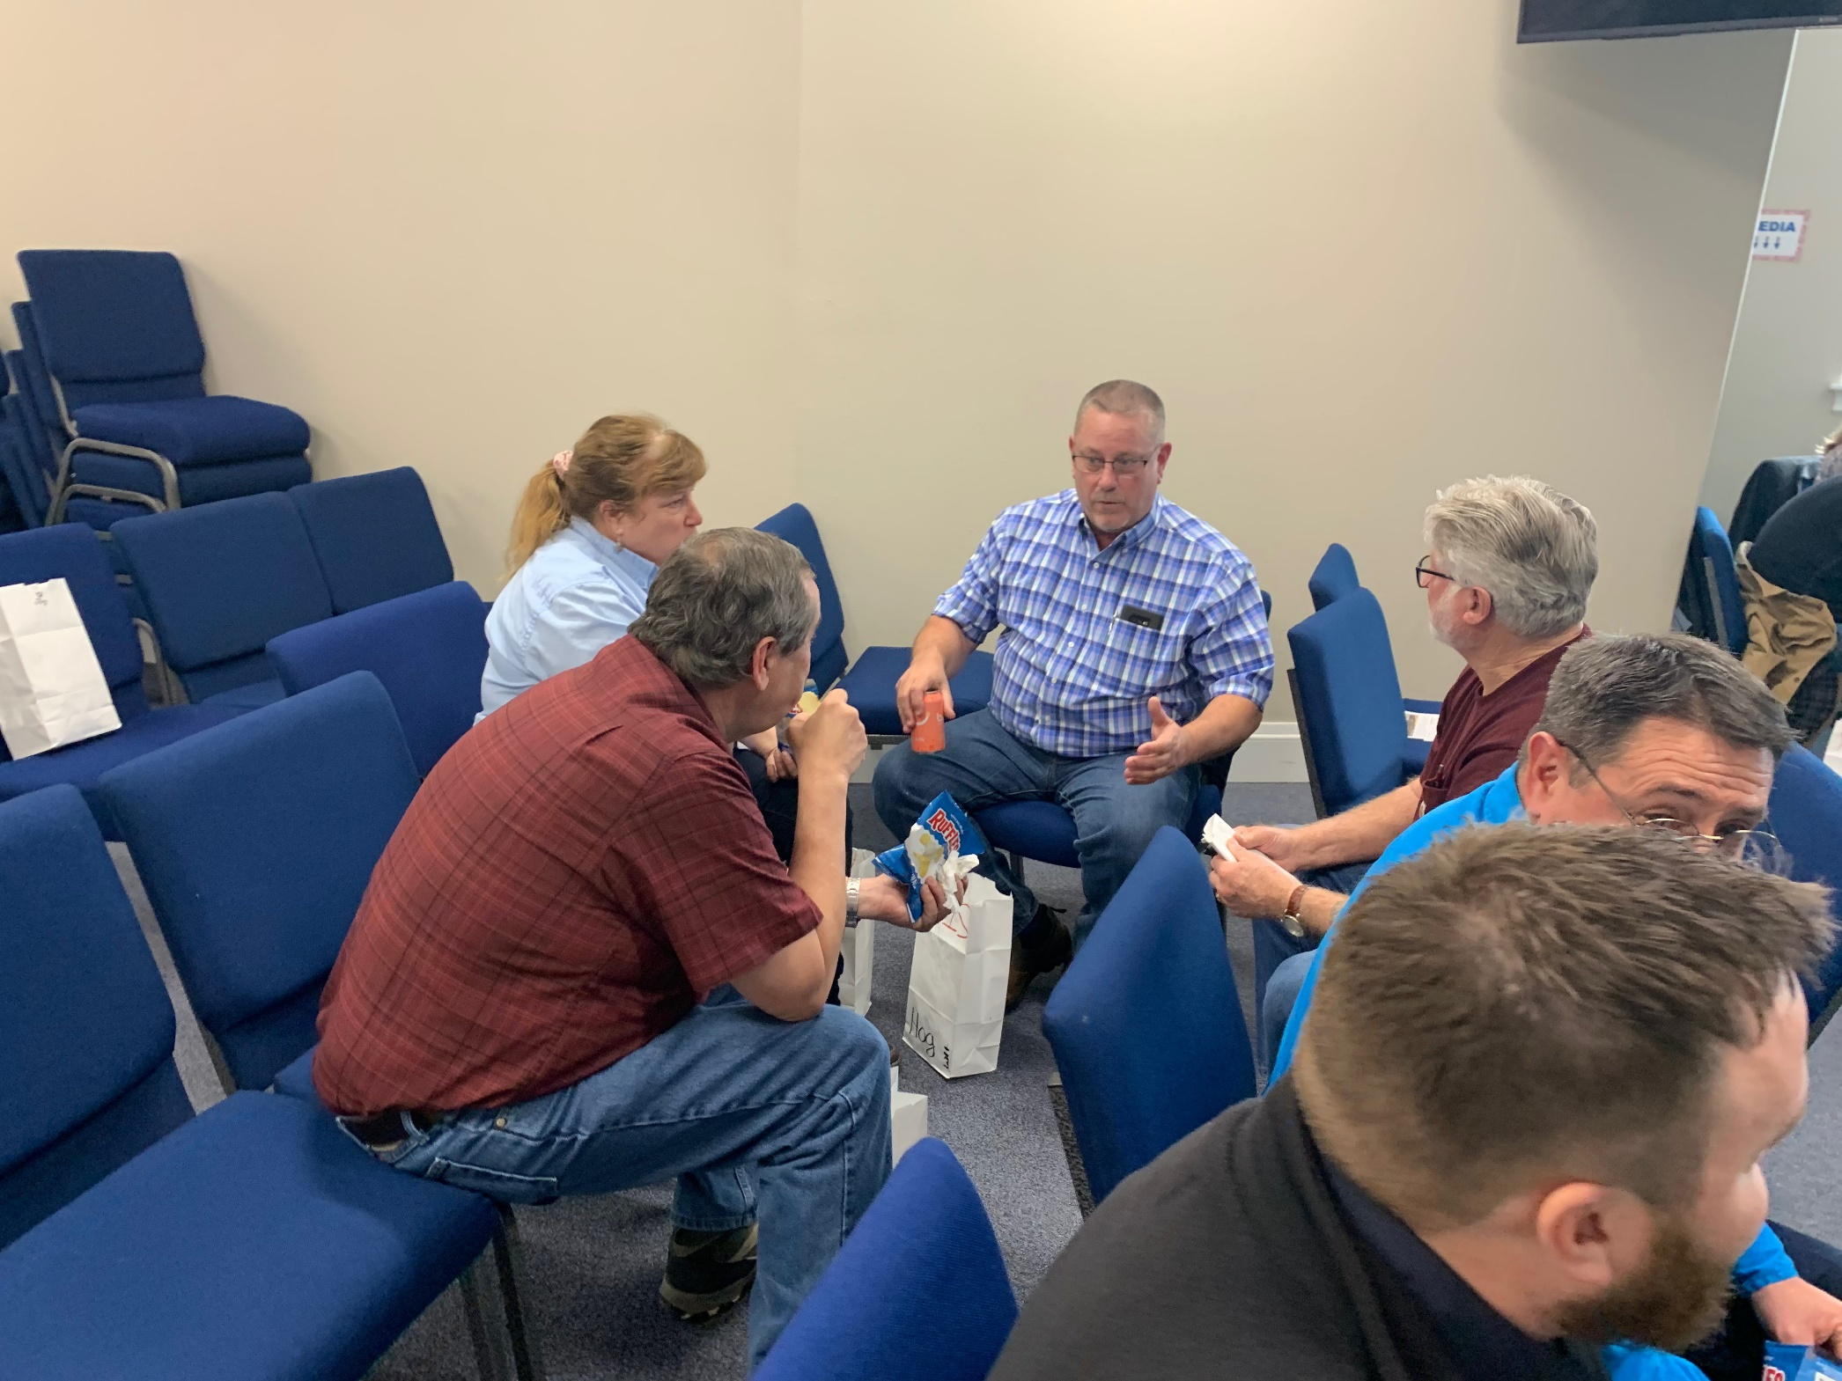
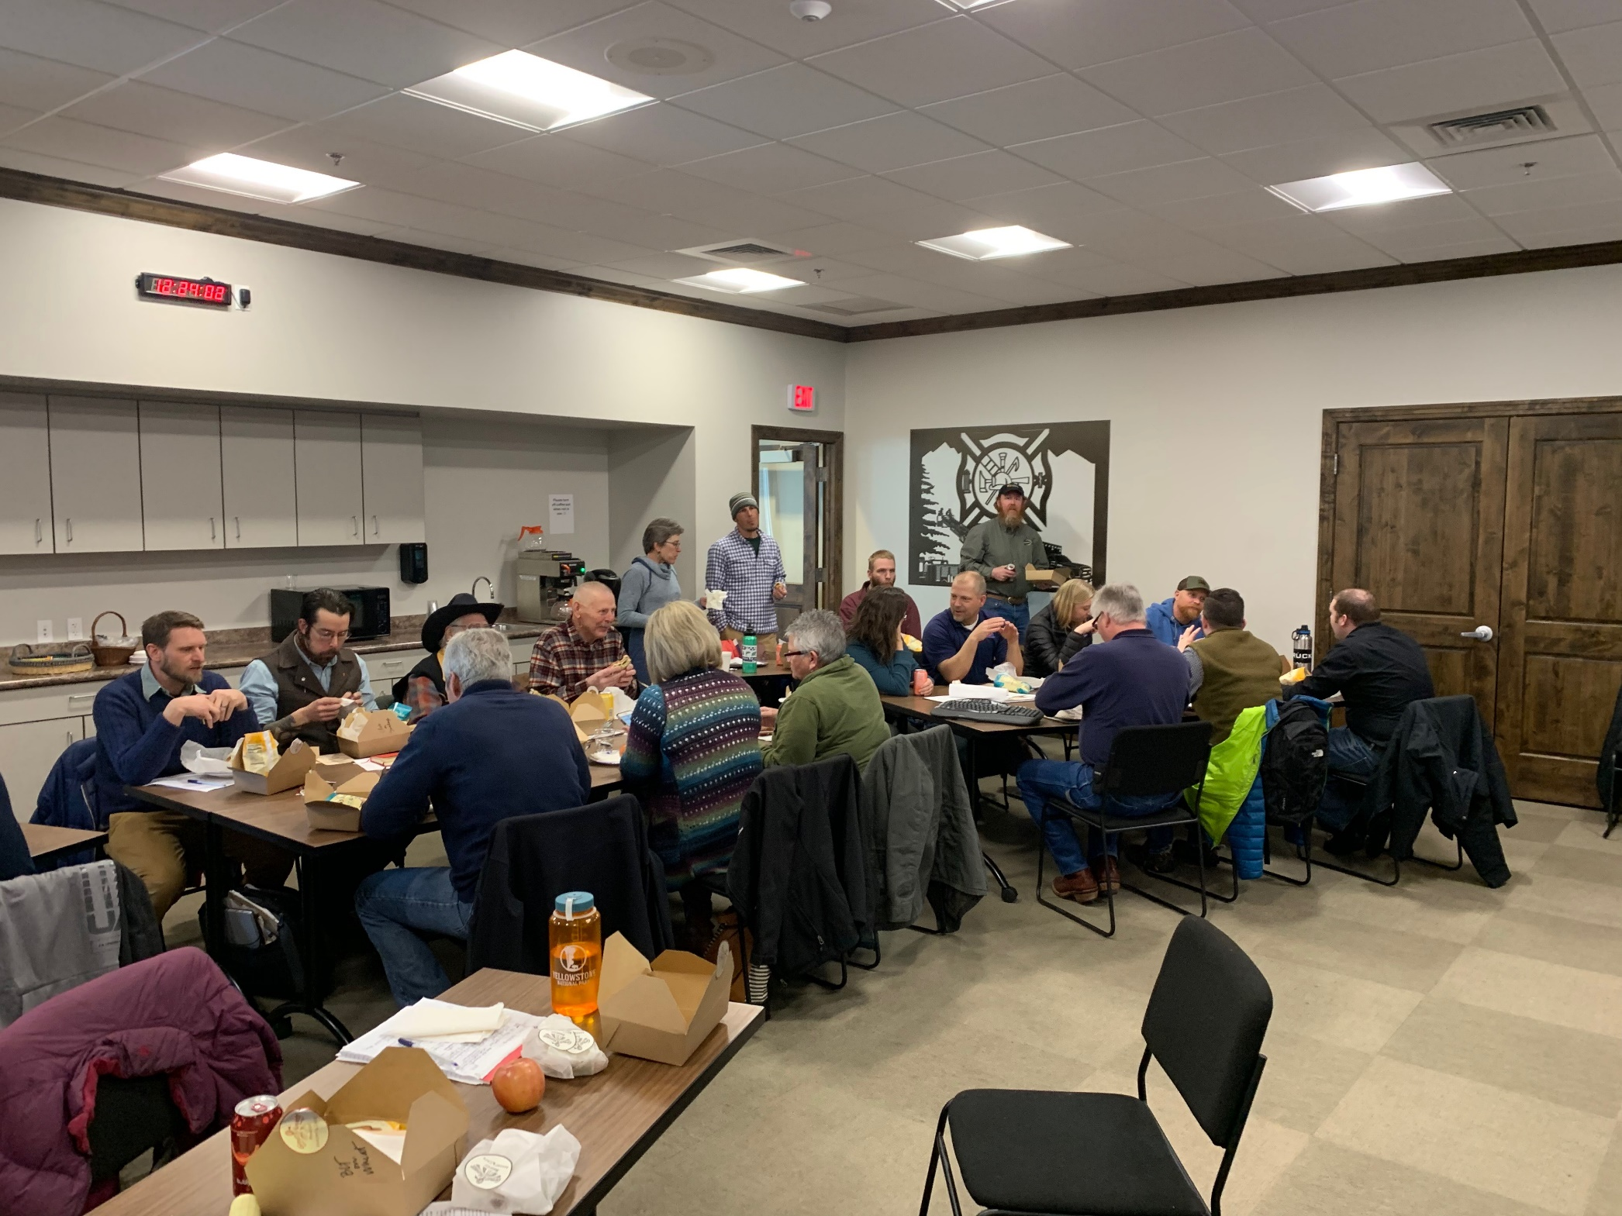
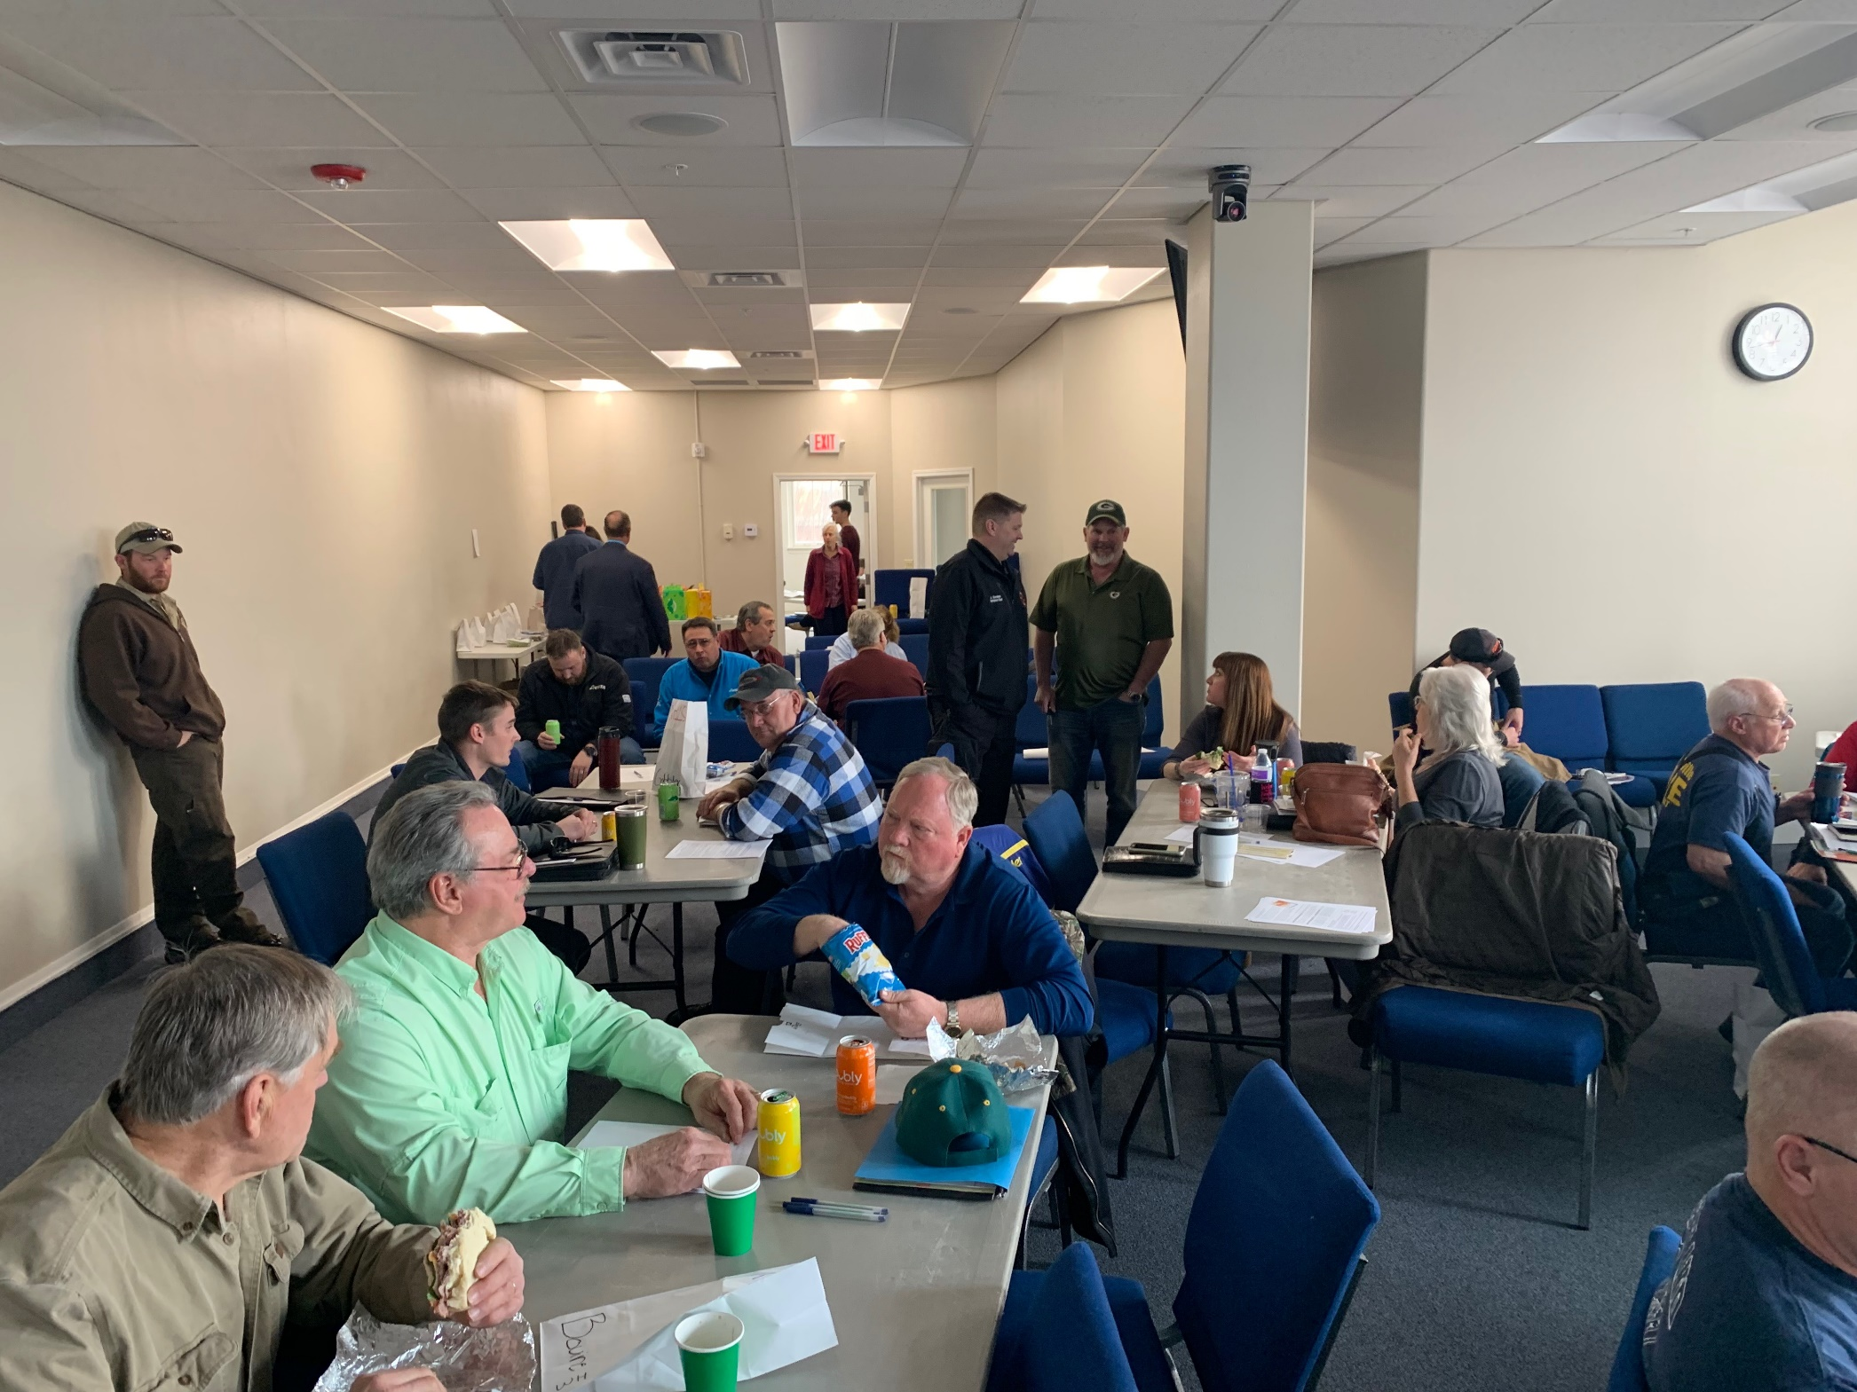
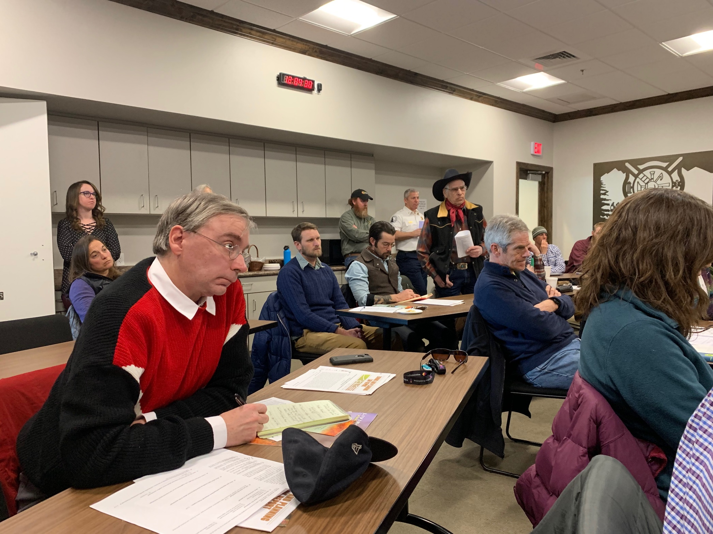

Slide 12
Fishbowls:
Owyhee County, Confirmed for May 14
Teton County
White Bird
Wilderness Lake Ranch Subdivision
Pocatello
Soda Springs

